Slide 1

Buckingham-PI theorem
Dimensional analysis
Fracture of materials

Slide 2
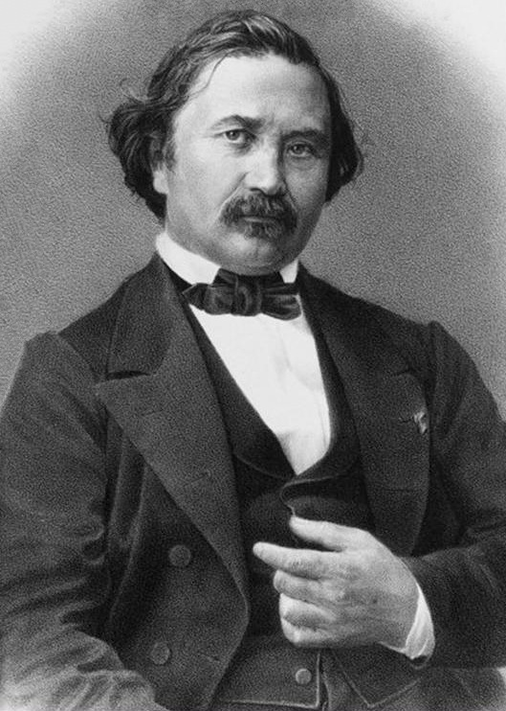
Statement
"If there is a physically meaningful equation involving a certain number n physical variables, then the original equation can be rewritten in terms of a set of p = n − k dimensionless parameters π₁, π₂, ..., π_{p} constructed from the original variables, where k is the number of physical dimensions involved."

Slide 3

Why is it useful ?
Find laws and equations based on physical variables
Get a better intuition of the important parameters of a system
Form precise laws from experiments (or theories)
NB: here π is not 3.1415 …. BUT a dimensionless parameter !

Slide 4
Steps of the theorem
Determine the N important system parameters (physical variables) for what we want to find
Build the matrix of the physical variables/dimensions and find its rank K
Determine the number of dimensionless groups p = N – K
N is the number of physical variables (speed, density, pressure...)
K is the number of physical dimensions (kg, m, s...) -> Always take base units for conveniance !
Build the p dimensionless groups
Find the equation for the physical parameter you are interested in !
If there is only one group, only one experiment will be necessary to find a numerical value of the dimensionless parameter π
If there is multiple group, multiple experiments will be necessary to find the link between them.

Slide 5
Exemple
We aim to find a relationship for the time t it takes for an object initially at rest to fall a certain distance h, under the influence of gravity g. (We neglect friction)
Step 1 :
What are the physical variables ?
What are their physical dimensions ?
t = [s]
h = [m]
g = [a] = [m/s²]
N = 3

Slide 6
Example
Step 2 : build the matrix with :
Physical variables in columns
Physical dimensions in row
 | t | g | h
s | 1 | -2 | 0
m | 0 | 1 | 1
This is a matrix of rank K = 2 !
Step 3 : Determine the number of dimensionless parameters p
P = N – K = 3 – 2 = 1

Slide 7
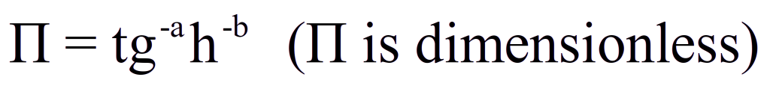
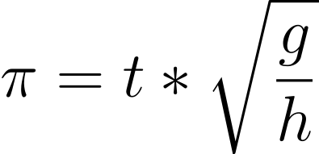
Example
Step 4 : Chose and build the p dimensionless parameters
We need only 1 : since we want to find t at the end, let's take it as a basis ! (we could also search h for a given t …)
We need to balance t with the other N-P physical variables to make π dimensionless
For easier resolution, let's replace the physical variables with their dimensions
We can solve this independently for each dimension !
second, T : 0 = 1 + 2a
meter, L : 0 = -a - b
a = -1/2
b = 1/2

Slide 8
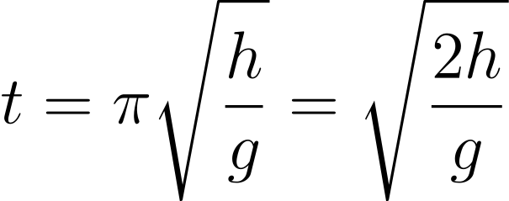
Example
Step 5 : let's find the relation for t !
If you know t, g and h, how many experiments will you need to do to determine the numerical value of π ?
After one experiment, we find π² = 2 !
By isolating t, we find :
Which is the same relation we would find by resolving kinetics with acceleration = g and initial speed = 0 !

Slide 9

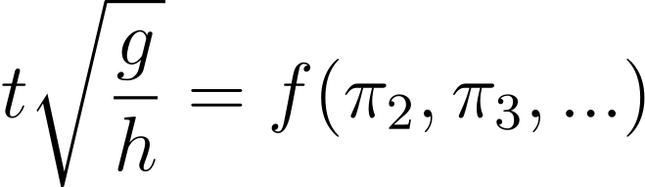
What if there is more than one dimensionless parameter ? (p > 1)
You need to make more experiments, varying the value of the physical variables to find this relation :
In our case, if there was more than one dimensionless parameter (for example, adding air drag/resistance), we would need to solve by experiments :
Be careful the relation f could be non-trivial ! (For example, the Reynold's number is a dimensionless parameter, influencing other equations through this f in complex ways !)

Slide 10
Any question ?
Exercices 1, 2 and 4 will be about Buckingham-Pi
Exercice 3 will be about wave propagation

